Slide 1
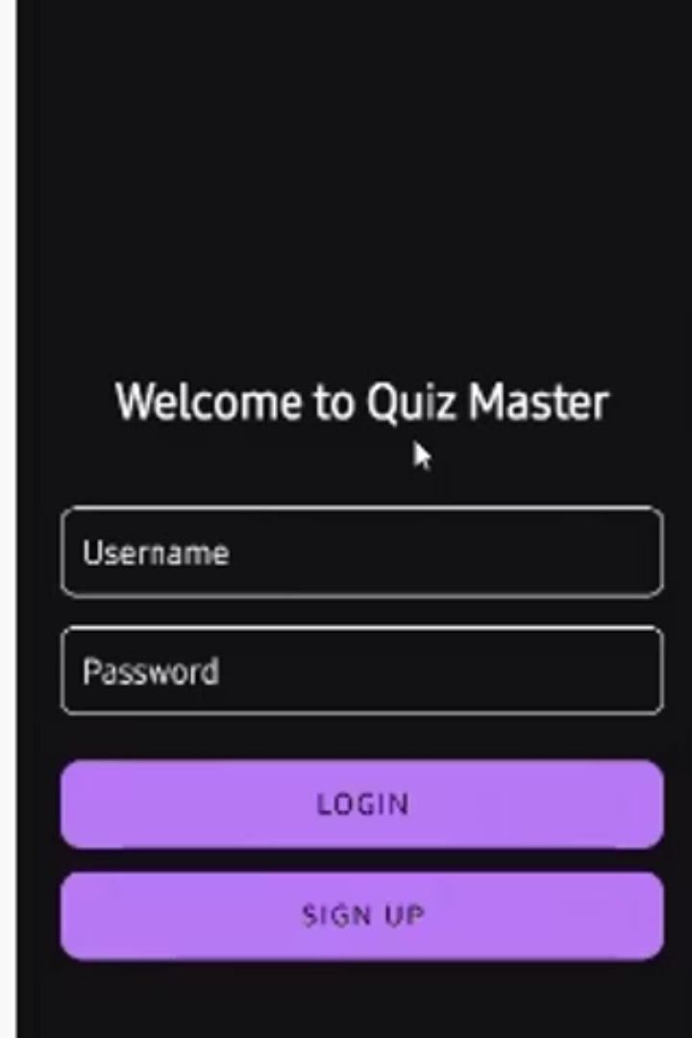

Interactive Quiz App – Learning Made Fun
A modern Android app with engaging design
Real-time scoring, instant feedback
Multiple quiz categories and leaderboards
Personalized user profiles
by Sathvik Reddy Sama

Slide 2
Seamless User Experience
Easy Registration
User Profiles
Secure sign-up and login process
Customize preferences and details
Navigation
UI Design
Intuitive bottom menu for quick access
Clean, modern look with Material Design
Progress Tracking
Screen Flow
View past performance and milestones
Smooth, responsive screen transitions

Slide 3
Engaging Quiz Experience
Question Format
Real-Time Scores
Multiple-choice style for clarity
Immediate updates during quizzes
Feedback
Timers
Instant answer correctness indicators
Enhance focus with time limits
Categories
Results
Select quizzes by topic
In-depth quiz performance analysis

Slide 4
Learning Through Competition
Global Leaderboard
Score Comparison
Rank against worldwide users
Challenge peers and friends
Achievements
Statistics
Track milestones earned
Comprehensive performance insights
Dynamic Ranking
Social Sharing
Real-time updates in standings
Share progress on social media

Slide 5




Technical Foundation
Java & Kotlin
SQLite
Material Design
Gradle
Robust, modern programming languages
Efficient local data storage
Consistent UI components
Scalable build system
Seamless Android SDK integration and optimized performance

Slide 6





Application Architecture
Activities
Login, Quiz, Results, Profile
Fragments
Quiz List, Leaderboard, Profile
Data Management
Database Helper handles SQLite operations
Authentication
Secure login and user data protection
Navigation
Modular UI and smooth user flow

Slide 7
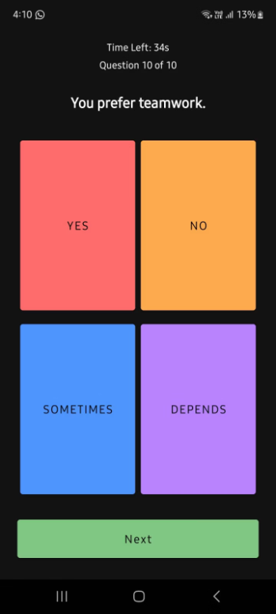
Screen from the App
all the of the options are of different color inorder to distinguishing from each other easier.

Slide 8
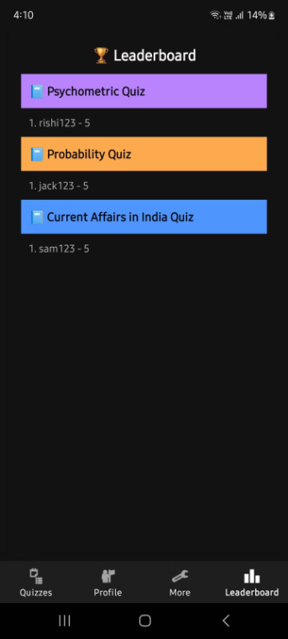
LEADERBOARD
This is a screen from the app that shows the leaderboard after the test is complete

Slide 9
Team Credits
Sindhuja Arnepalli
Nithyasri Vadapalli
AP22110011444 -
AP22110011443 -
Sathvik Reddy Sama
Rishitha Kota
AP22110011491
AP22110011489

